Slide 1


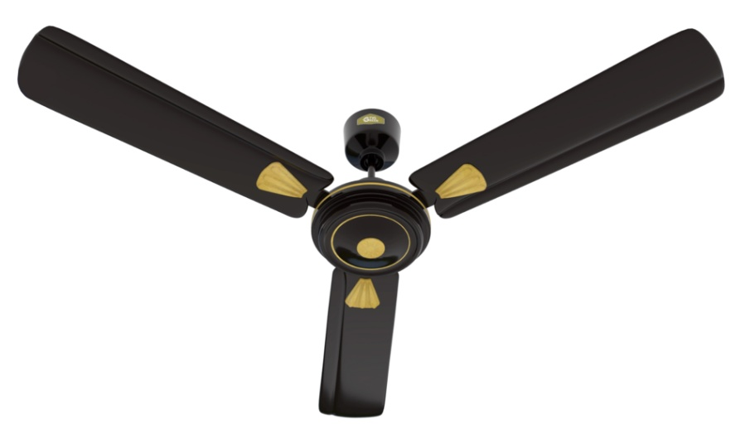
TVS GREEN HOME APPLIANCES
FROM THE HOUSE OF
LUCAS TVS

Slide 2




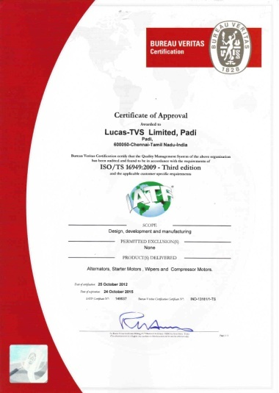
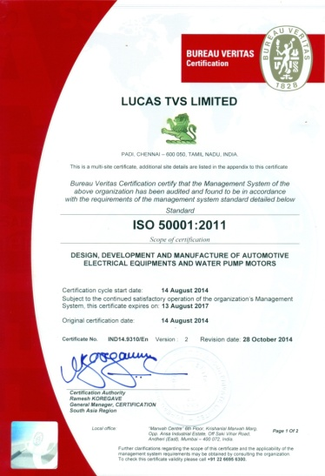
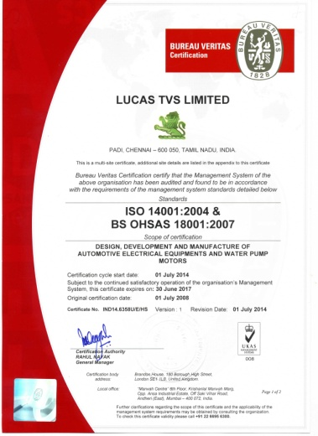
About Lucas TVS
Lucas TVS is a leader in Auto Electrical products in India, Globally recognized as a high-quality product supplier. Lucas TVS is a Deming Grand Prize awarded company for Quality and Systems. The company has been working on commercializing various inventions in the last 25 Years through its in-house R&D and Engineering.
BLDC is a one such technology, the company has been working on this for the last 10 years and applied on various Automotive applications. Now, Energy Saving becoming a crucial aspect even in households, we have developed a best-in-class domestic ceiling fan in terms of power saving and service ratio. our country have taken various steps towards reducing the consumption of electricity.
Lucas TVS has created a sub brand “TVS Green” to market their home appliances.
Factory
Deming Grand Prize
TS 16949
ISO 50001:2011
ISO 14001:2004

Slide 3
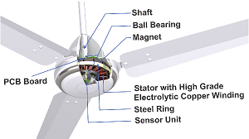
Benefits of In-build Electronics Circuits
The in-build controller design protects a electronic circuit against any external damages like water, moisture and External forces.
The cooling of electronic circuit becomes efficient and simple
This makes the design simple and sleek

Slide 4

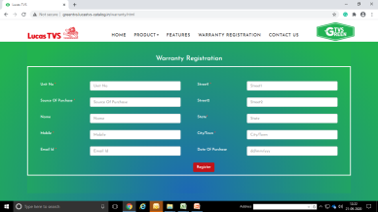

Warranty Uniqueness
TVS Green Offers 3 year warranty from the date of purchase
3 Year Warranty
Every fan sold is fixed with QR code to track the serial number of the fan
Online registration of warranty by customer
Toll Free line for warranty / Service
No repair & Unit replacement

Slide 5
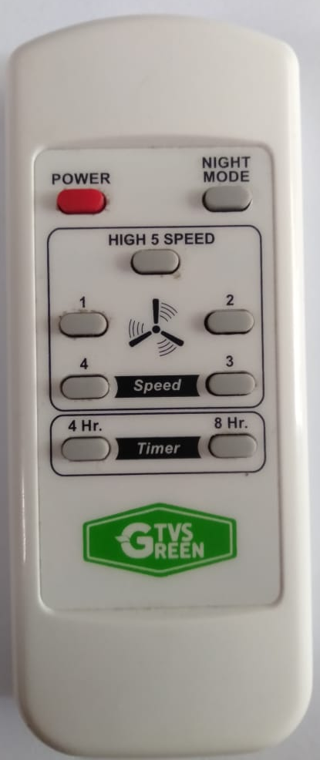

Remote Convenience
The Remote option facility gives various controls remotely
ON / OFF
Sleep Mode
ON / OFF Switch enables to start or Stop the Fan. When switched on the fan re-starts at the speed it was running earlier.
Enables customer to set ceiling fan in Sleep Mode, so that as the temperature drops during night the speed reduces automatically and as undisturbed and comfortable night long sleep
Speed Control
Timer Control
There are 5 speed controls. Speed-1 refers to lowest speed and Speed-5 refers to highest speed.
Helps to set the start timer as per requirement. There are 4 pre-set start timing option are built-in.

Slide 6
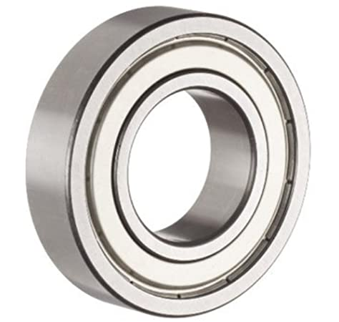
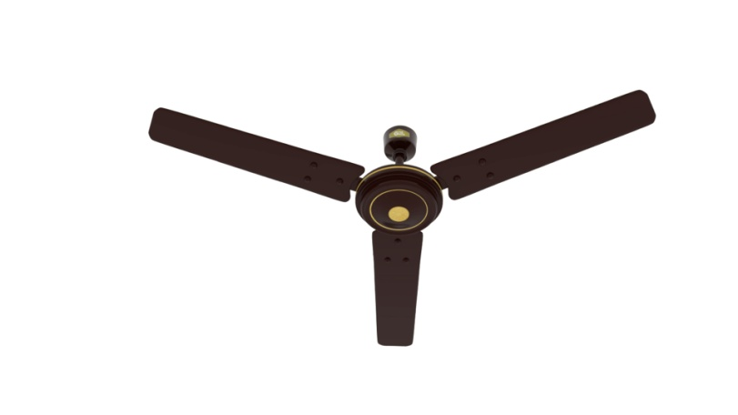
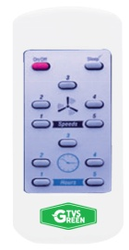
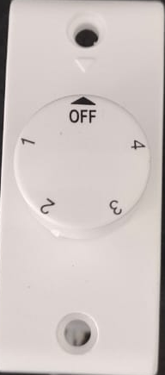
Technical Specification
S.NO | DESCRIPTION | SPECIFICATION
1 | Type | BLDC Domestic Ceiling Fan
2 | Sweep | 1200mm (48 Inch)
3 | Air Delivery (Min) | 215 Cu.m/min
4 | Operating Voltage range | 150-270 Volts
5 | Rated Frequency | 48 - 50Hz
6 | Power Consumption | 35W
7 | Power Consumption @ Low Speed | 10 W
8 | Power Consumption @ High Speed | 35 W
9 | Service Ratio | 6
10 | Power factor | 0.9 (at Max. Speed)
11 | Total Harmonic Distortion | 15%
12 | BEE Star Rating | 5 Star (to be obtained)
13 | No of Bearing | ZZ Shielded Double Ball Bearing
14 | Weight Including Packing | 3.0 Kgs
15 | Speed (Max) | 370 RPM
16 | No of speed setting | 1 to 5
17 | Remote range | 10 Feet
18 | Down rod STD Length | 10 Inch
19 | Warranty | 3Years (Motor only)
20 | Special Mode in Remote | Sleep Mode
Double side shielded Ball Bearing
3 Year Warranty
3 Year Warranty
Light Weight
Sleep Mode
Regulator Option

Slide 7
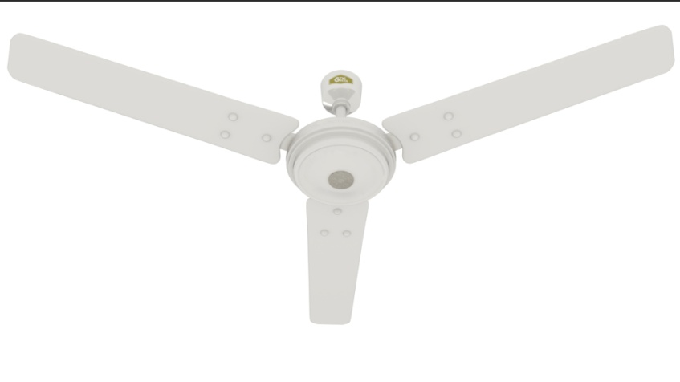
Power Saver
Consumes the lowest electricity with optimal air delivery
More suitable for Schools, Hospitals and Offices
Wall mounted high voltage regulator option available
Basic White, Ivory and Pearl white colour options
Technical Details
Air Delivery | Wattage | Size | Speed | Trim Lines | Control | Colour
215M³/m | 28W | 1200mm (48inch) | 370rpm | NA | Remote | Basic White
 |  |  |  |  | Regulator

Slide 8
Deluxe
Consumes lower electricity with improved air delivery
More suitable for Schools, Hospitals, Offices and Homes
Wall mounted high voltage regulator option available
Brown, Ivory and Pearl white colour options
Technical Details
Air Delivery | Wattage | Sweep | Speed | Trim Lines | Control | Colours Available
218M³/m | 32W | 1200mm (48inch) | 365rpm | 2 Golden Lines | Remote | Baker Brown
 |  |  |  |  |  | Brown
 |  |  |  |  |  | Ivory
 |  |  |  |  | Regulator | Baker Brown
 |  |  |  |  |  | Brown
 |  |  |  |  |  | Ivory

Slide 9
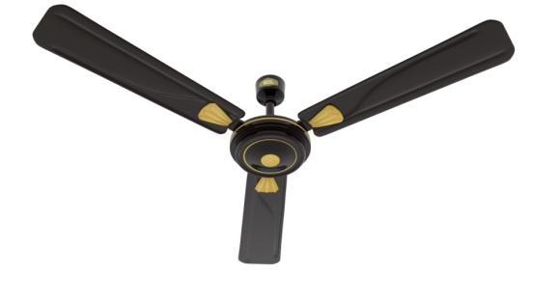
DÉCOR
Consumes lower electricity with best air delivery
More suitable for large rooms, wedding halls, Cinema Halls, Etc.,
Wall mounted high voltage regulator option available
Brown and Baker Brown colour options
Technical Details
Air Delivery | Wattage | Sweep | Speed | Trim Lines | Control | Colours Available
225M³/m | 35W | 1200mm (48inch) | 350rpm | 2 Golden Lines | Remote | Baker Brown
 |  |  |  |  |  | Brown
 |  |  |  |  | Regulator | Baker Brown
 |  |  |  |  |  | Brown

Slide 10
Return On Investment – Commercial Tariff
ROI in 18 Months
Savings in Commercial Tariff
 |  | ORDINARY FAN |  | TVS GREEN FAN
No. of hours Running / Day | Rate/ Unit (Rs) | Power Consumed/ Year (75W) | Expenses / Year (Rs) | Power Consumed/ Year (32W) | Expenses / Year (Rs) | Savings / Year (Rs)
5 | 10 | 137 | 1370 | 58 | 580 | 790
6 | 10 | 165 | 1650 | 70 | 700 | 950
7 | 10 | 193 | 1930 | 82 | 820 | 1110
8 | 10 | 221 | 2210 | 94 | 940 | 1270
9 | 10 | 249 | 2490 | 106 | 1060 | 1430
10 | 10 | 277 | 2770 | 118 | 1180 | 1590
11 | 10 | 305 | 3050 | 130 | 1300 | 1750
12 | 10 | 333 | 3330 | 142 | 1420 | 1910
13 | 10 | 361 | 3610 | 154 | 1540 | 2070
14 | 10 | 389 | 3890 | 166 | 1660 | 2230
15 | 10 | 417 | 4170 | 178 | 1780 | 2390
16 | 10 | 445 | 4450 | 190 | 1900 | 2550
17 | 10 | 473 | 4730 | 202 | 2020 | 2710
18 | 10 | 501 | 5010 | 214 | 2140 | 2870
19 | 10 | 529 | 5290 | 226 | 2260 | 3030
20 | 10 | 557 | 5570 | 238 | 2380 | 3190
TVS Green BLDC Ceiling Fan consumes 32W at full speed. The ordinary fan consumes 75W. Even at low speed the consumption of electricity remains at 75W.
TVS Green ceiling fan the consumption varies with speed. At the low speed the consumption is as low as 15W.
Generally the ceiling fan is operated at “speed 3” (equal to 200RPM) at this speed the consumption is around 20W which is equal to a LED bulb. However, the savings chart is taken at the full speed.
In commercial tariff usage, the return on investment is 18 months at 10 Hrs running

Slide 11
Return On Investment – Domestic Tariff
ROI in 3 Years
Savings in Domestic Tariff
 |  | ORDINARY FAN |  | TVS GREEN FAN
No. of hours Running / Day | Rate/ Unit (Rs) | Power Consumed/ Year (75W) | Expenses / Year (Rs) | Power Consumed/ Year (32W) | Expenses / Year (Rs) | Savings / Year (Rs)
5 | 5.00 | 137 | 685.00 | 58 | 290.00 | 395.00
6 | 5.00 | 165 | 825.00 | 70 | 350.00 | 475.00
7 | 5.00 | 193 | 965.00 | 82 | 410.00 | 555.00
8 | 5.00 | 221 | 1105.00 | 94 | 470.00 | 635.00
9 | 5.00 | 249 | 1245.00 | 106 | 530.00 | 715.00
10 | 5.00 | 277 | 1385.00 | 118 | 590.00 | 795.00
11 | 5.00 | 305 | 1525.00 | 130 | 650.00 | 875.00
12 | 5.00 | 333 | 1665.00 | 142 | 710.00 | 955.00
13 | 5.00 | 361 | 1805.00 | 154 | 770.00 | 1035.00
14 | 5.00 | 389 | 1945.00 | 166 | 830.00 | 1115.00
15 | 5.00 | 417 | 2085.00 | 178 | 890.00 | 1195.00
16 | 5.00 | 445 | 2225.00 | 190 | 950.00 | 1275.00
17 | 5.00 | 473 | 2365.00 | 202 | 1010.00 | 1355.00
18 | 5.00 | 501 | 2505.00 | 214 | 1070.00 | 1435.00
19 | 5.00 | 529 | 2645.00 | 226 | 1130.00 | 1515.00
20 | 5.00 | 557 | 2785.00 | 238 | 1190.00 | 1595.00
TVS Green BLDC Ceiling Fan consumes 32W at full speed. The ordinary fan consumes 75W. Even at low speed the consumption of electricity remains at 75W.
TVS Green ceiling fan the consumption varies with speed. At the low speed the consumption is as low as 15W.
Generally the ceiling fan is operated at “speed 3” (equal to 200RPM) at this speed the consumption is around 20W which is equal to a LED bulb. However, the savings chart is taken at the full speed.
In commercial tariff usage, the return on investment is 3 Years at 10 Hrs running

Slide 12
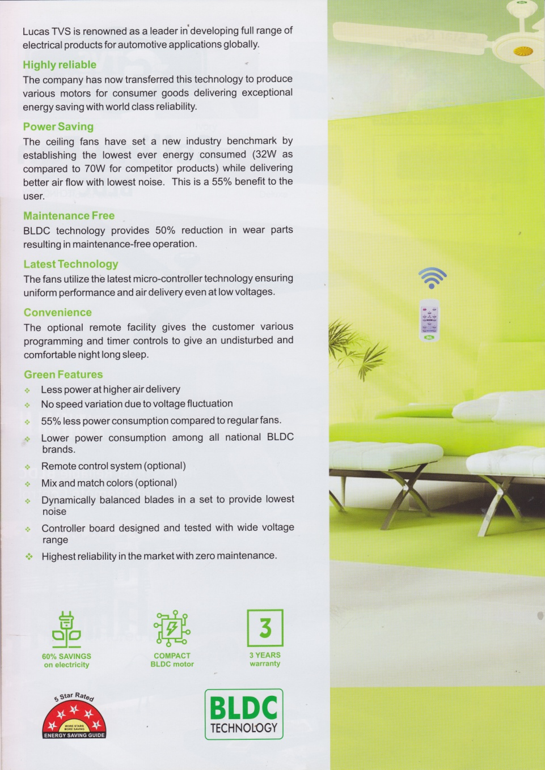
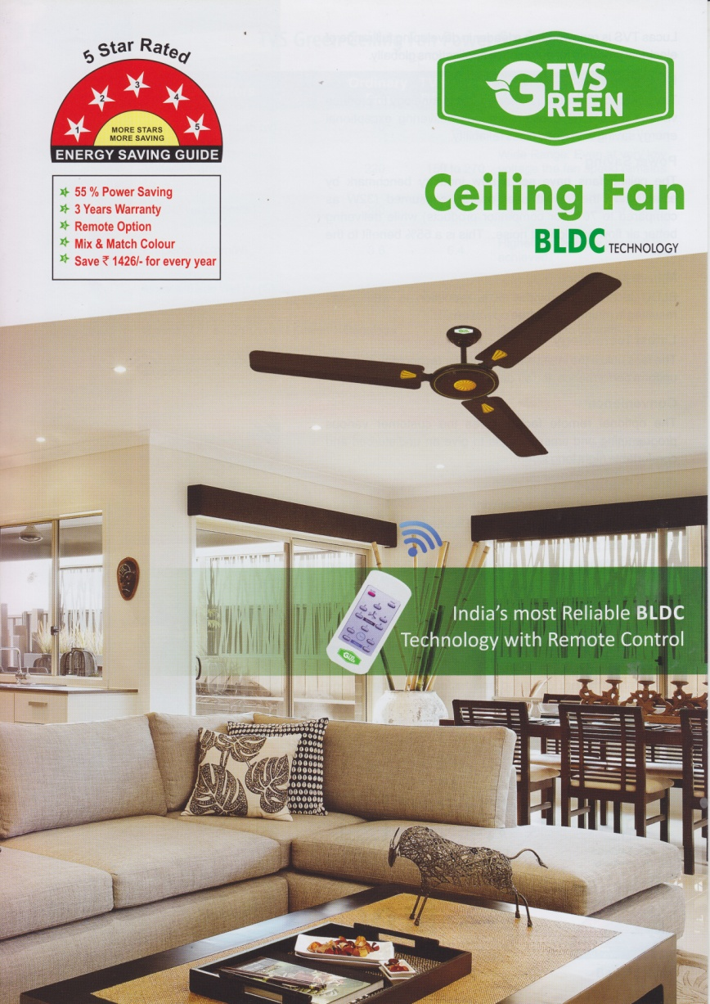
LEAFLET

Slide 13
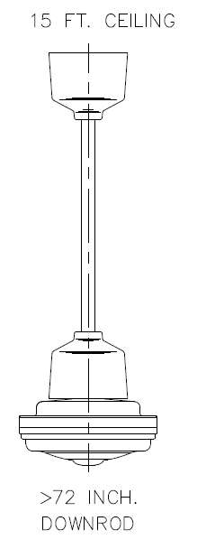
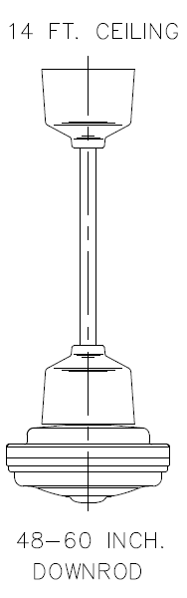
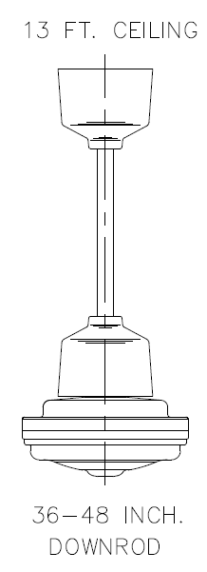
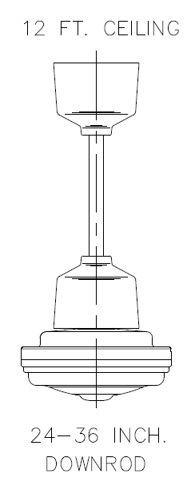
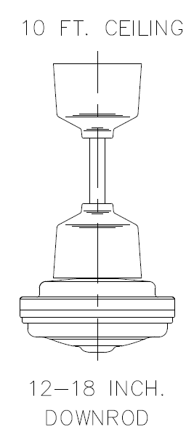
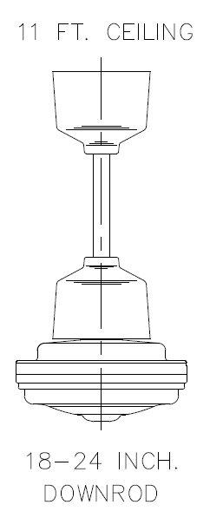
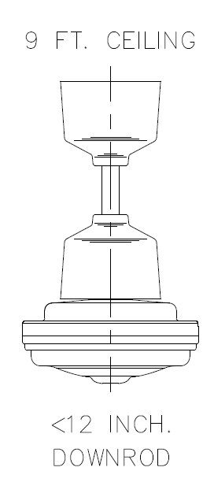
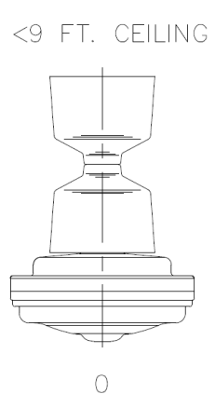
Down rod length recommendation chart
TVS Green will provide 10.3 inches long down rod as a standard fitment with every fan. This as per industry practice.
Normally longer down rod requirement arises during institutional installations, which is procured by end user.

Slide 14
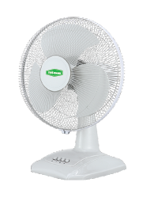
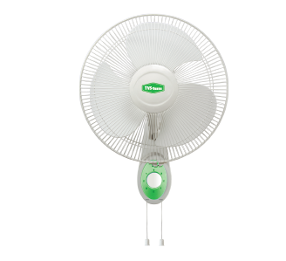
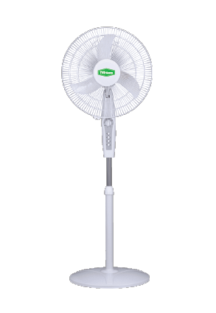
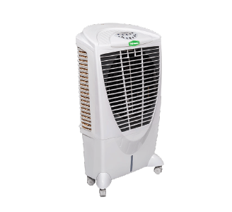
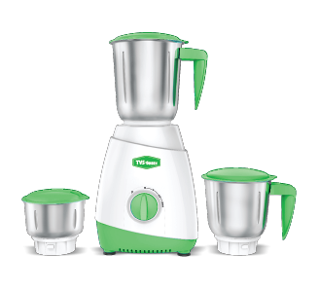
Upcoming Products
BLDC Table Top
BLDC Wall Mount
BLDC Pedestal
Air Cooler
Commercial Use Mixie

Slide 15
Thank you

